Slide 1
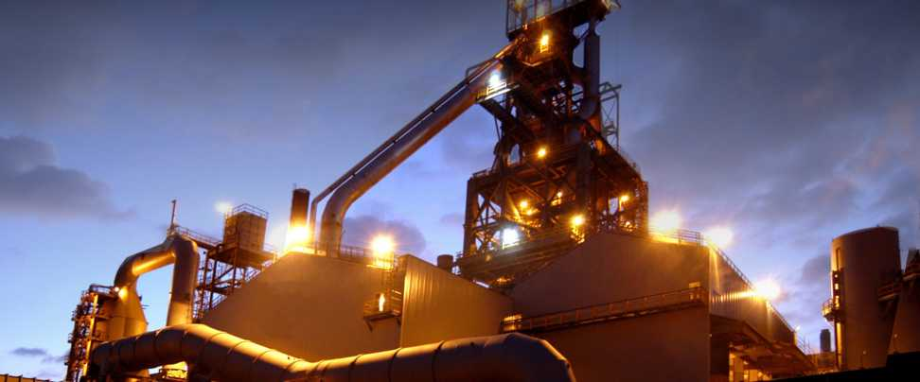
Iron & Steel Production
Process & Applications
Steve Gibbons, Area Sales Management, November 2009

Slide 2
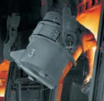
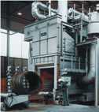

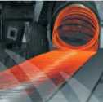
Iron & Steel Production
Introduction
The production of steel at an integrated iron and steel plant is accomplished using several interrelated processes.
The major operations related to gas analysis are:
  Coke production
  Sinter production
  Iron production
  Steel production
  Steel Refining
For ABB, the manufacturing of iron and steel is very important.
In nearly all phases of steelmaking, from iron ore to after-treatment of the steel, the gas concentrations have to be monitored exactly.
The measured values are mainly needed for process control. They play an essential part in assuring profitable steelmaking and a high product quality.
© ABB
June 03/2009 | Slide <number>

Slide 3
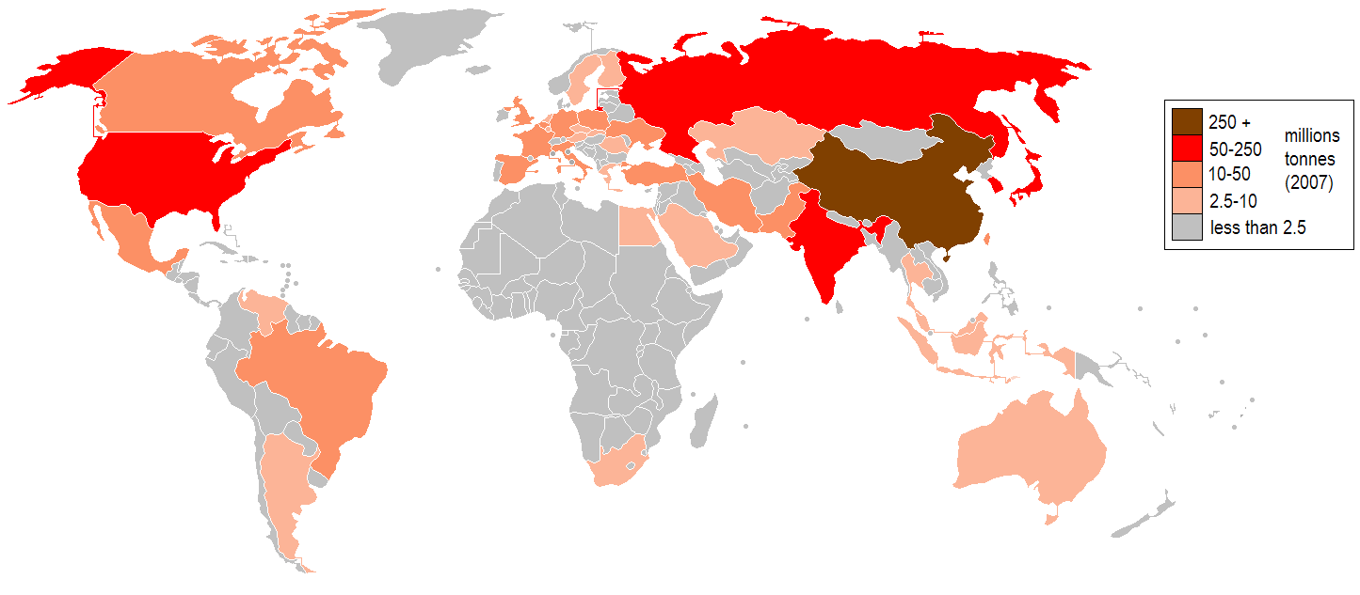
World Steel Production
By Country
© ABB
June 03/2009 | Slide <number>

Slide 4
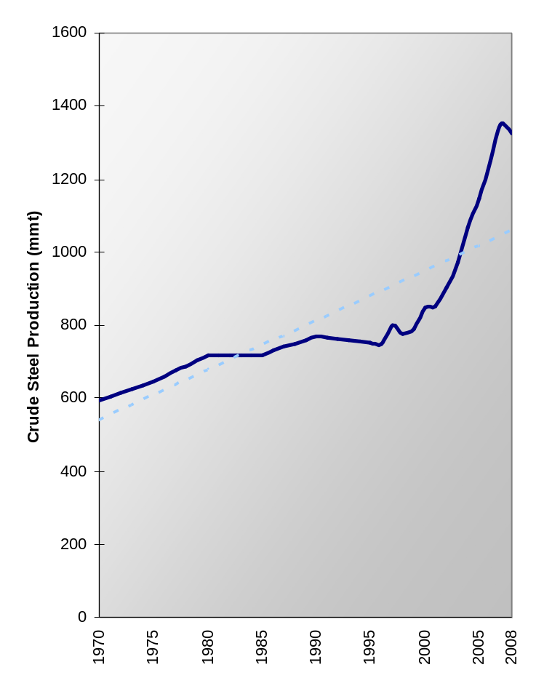
World Steel Production
History
72% increase in global steel
consumption between 1997-2007
295% increase in China
172% increase in Middle East
122% increase in CIS region
Compared to 33% increase in EU27
Major growth to come from
developing countries
India expected to increase to 124mmt per annum by 2012 and to 275mmt per annum by 2020
mmt = million metric tonnes
© ABB
June 03/2009 | Slide <number>

Slide 5
World Steel Production
By Country
World biggest steel producers in 2008
(Total world steel output in 2008: 1,326.5 million metric tons)
 | Country | mmt |  |  | Country | mmt
1 | China | 500.5 |  | 11 | Turkey | 26.8
2 | Japan | 118.7 |  | 12 | Taiwan, China | 19.9
3 | United States | 91.4 |  | 13 | Spain | 18.6
4 | Russia | 68.5 |  | 14 | France | 17.9
5 | India | 55.2 |  | 15 | Mexico | 17.2
6 | South Korea | 53.6 |  | 16 | Canada | 14.8
7 | Germany | 45.8 |  | 17 | United Kingdom | 13.5
8 | Ukraine | 37.1 |  | 18 | Belgium | 10.7
9 | Brazil | 33.7 |  | 19 | Iran | 10.0
10 | Italy | 30.6 |  | 20 | Poland | 9.7
© ABB
June 03/2009 | Slide <number>

Slide 6
World Steel Production
Major Companies
Company | Location | mmt
ArcelorMittal | India / Global | 103.3
Nippon Steel | Japan | 35.6
Baosteel | China | 35.4
Hebei Iron & Steel | China | 33.3
POSCO | Korea | 33.1
JFE Steel | Japan | 33.0
Wuhan Iron & Steel | China | 27.7
Tata Steel | India / Global | 24.4
Anshan-Benxi | China | 23.4
Shagang | China | 23.3
© ABB
June 03/2009 | Slide <number>

Slide 7
European Steel Production
Facts & Figures
Country | Number of Sintering Plants | Number of Coke Oven Plants | Number of Blast Furnaces | Number of Basic Oxygen Furnaces | Number of Electric Arc Furnaces
Austria | 2 | 1 | 6 | 5 | 3
Belgium | 4 | 3 | 4 | 8 | 7
Bulgaria | 0 | 0 | 3 | 3 | 6
Czech Republic | 2 | 4 | 6 | 4 | 16
Finland | 1 | 1 | 3 | 8 | 3
France | 5 | 4 | 10 | 7 | 25
Germany | 8 | 5 | 18 | 21 | 42
Greece | 0 | 0 | 0 | 0 | 7
Hungary | 2 | 0 | 2 | 2 | 2
Italy | 2 | 4 | 6 | 9 | 44
Netherlands | 1 | 1 | 2 | 3 | 2
Poland | 2 | 7 | 7 | 6 | 12
Portugal | 1 | 1 | 0 | 5 | 2
Romania | 0 | 0 | 4 | 4 | 7
Slovakia | 1 | 1 | 3 | 4 | 1
Slovenia | 0 | 0 | 0 | 0 | 3
Spain | 1 | 5 | 2 | 5 | 28
Sweden | 0 | 2 | 3 | 3 | 8
United Kingdom | 3 | 5 | 7 | 8 | 10
Total | 35 | 44 | 86 | 101 | 231
© ABB
June 03/2009 | Slide <number>

Slide 8
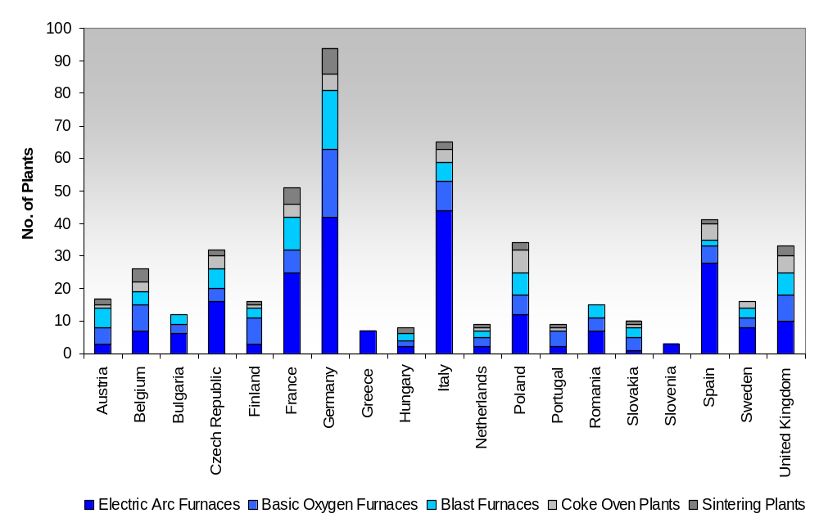
European Steel Production
Facts & Figures
© ABB
June 03/2009 | Slide <number>

Slide 9




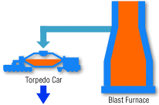


Ironmaking Process
Process Flow Diagram
Click
Here
Click
Here
Click
Here
Click
Here
© ABB
June 03/2009 | Slide <number>

Slide 10







Steelmaking Process
Process Flow Diagram
Click
Here
Click
Here
© ABB
June 03/2009 | Slide <number>

Slide 11
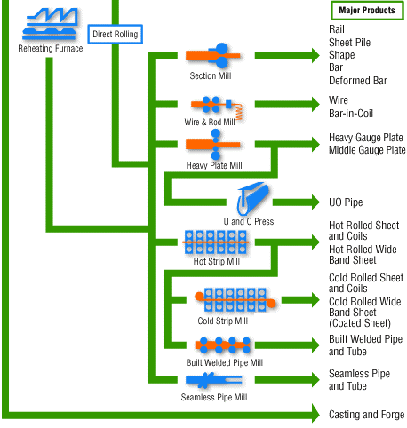
Steel Refining
Process Flow Diagram
Click
Here
© ABB
June 03/2009 | Slide <number>

Slide 12
Coke Furnace
Process Description
Coke is used as a fuel and as a reducing agent in smelting iron ore in a Blast Furnace.
It is usually produced from coal; the process is called coking.
Volatile constituents of the coal including water, coal-gas, and coal-tar are driven off by baking in an airless furnace or oven at temperatures as high as 2,000°C. This fuses together the fixed carbon and residual ash.
Coke oven gas is rich in CO and hydrocarbons. Ammonia and coal tar products such as benzene and toluene are removed by scrubbing.
The cleaned gas is used as a fuel in the steel-making plant or for firing the coke ovens.
Continuous measurement of CH₄, CO and CO₂ are often required.
Flue gas oxygen measurements are also made to optimize combustion in the oven heaters.
Back to
Ironmaking
© ABB
June 03/2009 | Slide <number>

Slide 13
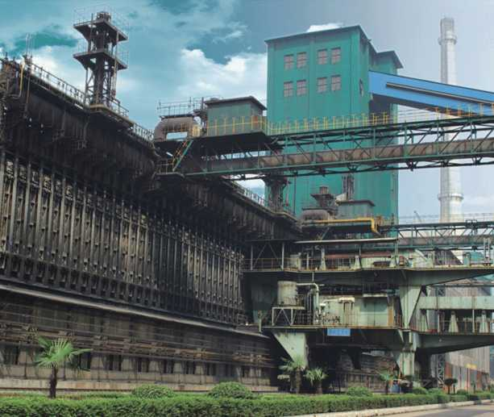
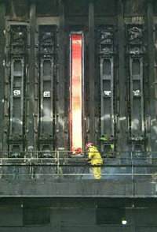
Coke Furnace
Pictures
© ABB
June 03/2009 | Slide <number>

Slide 14
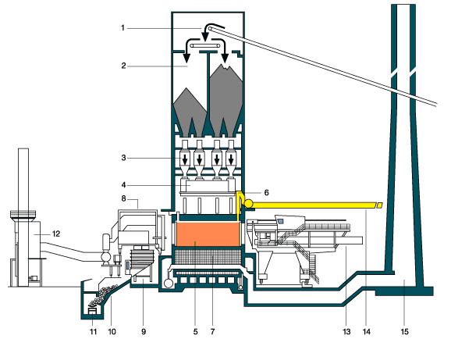
Coke Furnace
Process Diagram
Coal from mixing & grinding plant
Coal bunker
Weighing containers
Charging car
Coke oven chamber
Riser
Regenerator
Transfer machine
Quenching car
Coke wharf
Coke for the blast furnace
Dedusting of coke output
Coke pusher
Gas for the coal by products plant
Chimney
© ABB
June 03/2009 | Slide <number>

Slide 15
Coke Furnace
Process Flow Diagram
Coal
Charging
Car
2
Flue gas
cleaning
1
Coke furnace
Sinter Plant
Blast Furnace
Back to
Ironmaking
Fuel/Air
© ABB
June 03/2009 | Slide <number>

Slide 16
Coke Furnace
Measuring Points
Summary
Measuring Point | Measuring Task | Measuring Components | Analyzers
1 | Process Optimization | CO, CO₂, O₂ | Uras26 Magnos206
2 | Emission Monitoring | CO, NO_{x}, SO₂, O₂ | Uras26 Magnos206
Back to
Ironmaking
© ABB
June 03/2009 | Slide <number>

Slide 17
Sinter Plant
Process Description
The sintering process converts fine-sized raw materials, including iron ore, coke breeze, limestone, mill scale, and flue dust, into an agglomerated product, “sinter”, of suitable size for charging into the blast furnace.
The raw materials are sometimes mixed with water to provide a cohesive matrix, and then placed on a continuous, travelling grate called the sinter strand.
A burner hood, at the beginning of the sinter strand ignites the coke in the mixture, after which the combustion is self supporting and it provides sufficient heat, 1300 to 1480°C (2400 to 2700°F), to cause surface melting and agglomeration of the mix.
On the underside of the sinter strand is a series of wind boxes that draw combusted air down through the material bed into a common duct, leading to a gas cleaning device. The gas is rich in SO2 with high dust load.
CO, CO₂ and O₂ are measured continuously to observe the progress of the sintering process. Some users also monitor water vapor in the exhaust gas.
Back to
Ironmaking
© ABB
June 03/2009 | Slide <number>

Slide 18







Sinter Plant
Furnace Diagram
100 ..... 400 °C
Sinter band
Air
© ABB
June 03/2009 | Slide <number>

Slide 19
Sinter Plant
Process Flow Diagram
Raw ore
Crushing &
Grinding
Mixer
Pelletizing
Sintering furnace
1
2
Fuel/Air
Flue gas
cleaning
Pellets
Blast Furnace
© ABB
June 03/2009 | Slide <number>

Slide 20
Sinter Plant
Measuring Points
Summary
Measuring Point | Measuring Task | Measuring Components | Analyzers
1 | Kiln Optimization | CO, CO₂, O₂ | Uras26 Magnos206
2 | Emission Monitoring | NO_{x}, SO₂, O₂ | Uras26 Magnos206
Back to
Ironmaking
© ABB
June 03/2009 | Slide <number>

Slide 21

Blast Furnace
Process Description
The blast furnace process is still the most important procedure to reduce iron ore. The share of this process in production is more than 90%.
The blast furnace is a shaft furnace which is fed from above with coke, with ore and admixture materials alternately. These layers sink slowly to the warmer regions of the furnace. Hot air with a temperature of up to 1300°C is blown into the furnace through tuyeres in the lower furnace.
This hot wind burns the coke and ascends as reduction gas with the components CO, CO₂, H₂ and H₂O and the inert component N₂ in the countercurrent to the coke and ore.
Optimum utilization of the blast furnace results in a specific composition of the furnace gas, which depends on the composition of the feed material.
Continuous measurement of CO, CO₂ and H₂ in the furnace gas is essential for the economic operation and quality of the pig iron.
Back to
Ironmaking
© ABB
June 03/2009 | Slide <number>

Slide 22
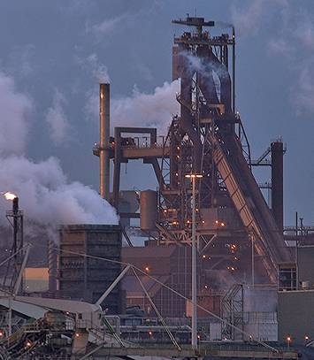
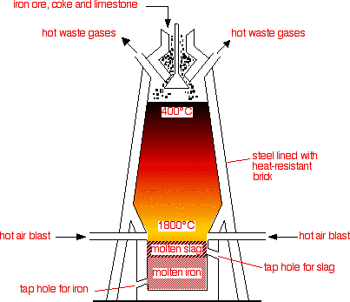
Blast Furnace
Process Diagram
© ABB
June 03/2009 | Slide <number>

Slide 23
Blast Furnace
Process Flow Diagram
1
2
3
4
5
6
Consumer
Natural-
gas
Cowper 1
Cowper 2
Top gas cleaning
Hot Blast Gas
Cold Air
© ABB
June 03/2009 | Slide <number>

Slide 24
Blast Furnace
Measuring Points
Summary
Measuring Point | Measuring Task | Measuring Components | Analyzers
1 | Transverse Probe (Above Burden / Under Burden) Blast Furnace Optimization | CO, CO₂, H₂, (O₂) | Uras26 Caldos27 (Magnos206)
2 | Riser Tube Measurement Oven Symmetry | CO, CO₂, H₂ | Uras26 Caldos27
3 | Top Gas Measurement - Gas very dirty | CO, CO₂, H₂ | Uras26 Caldos27
4 | Top Gas Measurement - Gas semi clean | CO, CO₂, H₂ | Uras26 Caldos27
5 | Cowper Waste Gas Burner Optimization | CO, O₂ | Uras26
6 | Emission Monitoring | CO, NO_{x}, SO₂, O₂ | Uras26 Magnos206
Back to
Ironmaking
© ABB
June 03/2009 | Slide <number>

Slide 25

Blast Furnace
Measuring Points
Uras26
CO 0...30 vol%
CO₂ 0…20 vol%
Caldos27
H₂ 0...4 vol%
CS Correction
Sample gas
I
O
I
O
1
-
4
Measuring Task:
  Top gas analysis:
    H₂ in N₂ with cross-sensitivity correction using Uras26
  Typical gas composition:
    H₂ 1...4 vol%, CH₄ 0...4 vol%, CO 25...30 vol%, CO₂ 10...16 vol%, N₂ 52...60 vol%
Back to
Ironmaking
© ABB
June 03/2009 | Slide <number>

Slide 26
Blast Furnace
Measuring Tasks
5
Measuring task:
  Cowper Waste Gas – Burner Optimization
  Components: CO, O₂
Measuring task:
  Emission monitoring
  Components: CO, NO_{x}, SO₂, O₂
6
Back to
Ironmaking
© ABB
June 03/2009 | Slide <number>

Slide 27
Decarburization & Desulphurization
Process Description
The molten iron from the blast furnace contains undesirable amounts of carbon, manganese, silicon, sulphur, phosphorus and minor quantities of other elements, which are reduced or removed in the steel making process.
However, for economical or quality control reasons, additional processes are often introduced prior to steel making.
After initial melting the metal is then transferred to a vessel where it will be subjected to three steps of refining:
  Decarburization
  Reduction
  Desulphurization
Decarburization and desulphurization represent additional opportunities for gas analysis as will be described in the next few slides.
Back to
Ironmaking
© ABB
June 03/2009 | Slide <number>

Slide 28
Argon Oxygen Decarburization (AOD)
Process Description / Measuring Tasks
The Argon Oxygen Decarburization (AOD) process is used for decarburizing low-carbon stainless steel and nickel alloys and is carried out in a converter vessel.
Initial melting is carried out in an electric arc furnace. The melt is then transferred by ladle and poured into the AOD converter, where an argon-oxygen gas mixture is injected into the bath through tuyeres.
The refined stainless steel and slag are tapped off by rotating the converter. High-temperature off-gas, containing a significant quantity of carbon monoxide, is generated.
Measuring Point | Measuring Task | Measuring Components | Analyzers
1 | AOD Converter Off-Gas Process Control | CO | Uras26
Back to
Ironmaking
© ABB
June 03/2009 | Slide <number>

Slide 29
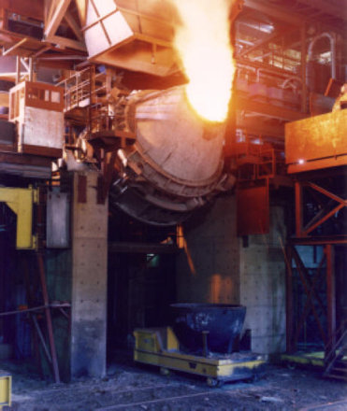
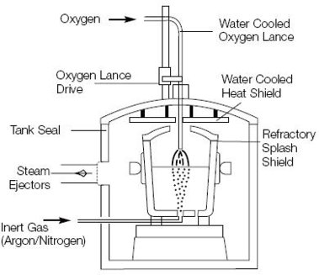
Argon Oxygen Decarburization (AOD)
Process Diagram
CO, CO₂
CH₄, H₂
C
and
Fe₂O₃
© ABB
June 03/2009 | Slide <number>

Slide 30
Hot Metal Desulphurization (HMDS)
Process Description / Measuring Tasks
Sulphur is mainly present in iron ore and in coal. Reducing sulphur content to < 0.020% in the blast furnace is difficult from an economical standpoint.
Today specified sulphur concentrations (typically between 0.001 and 0.020 %) for charging in the Basic Oxygen Furnace are commonly adjusted in a hot metal desulphurization facility.
It is now common practice to deep-inject the reactants, comprising salt-covered magnesium granules or calcium carbide, into the ladle using a refractory lance and inert carrier gas.
In this case the Calcium Carbide is used as desulphurizing agent and the silo where Calcium Carbide is stored is monitored for C₂H₂ to ensure that no fire is there. O₂ is also monitored.
Measuring Point | Measuring Task | Measuring Components | Analyzers
1 | Calcium Carbide Silo Safety Monitoring | C₂H₂, O₂ | Uras26 Magnos206
2 | Magnesium Silo Safety Monitoring | O₂ | Magnos206
Back to
Ironmaking
© ABB
June 03/2009 | Slide <number>

Slide 31
Basic Oxygen Furnace
Process Description
In the Basic Oxygen Furnace (BOF), molten iron (~70%) from a blast furnace and iron scrap (~30%) are refined in a furnace by lancing (i.e. injecting) high-purity oxygen.
A water-cooled oxygen lance is lowered to a fixed position above the liquid metal charge and high-pressure oxygen is blown onto the surface at supersonic speed. The oxygen reacts with carbon and other impurities to remove them from the metal.
During the blowing process, some elements react with oxygen to release heat. At the same time, carbon burns to form CO and CO₂, whereby CO₂ is further reduced to CO and O₂. Some of the iron is oxidized and is entrained in the flue gas as dust particles.
The full furnace cycle typically ranges from 25 to 45 minutes.
Continuous measurement of CO, CO₂ and H₂ in the furnace gas is essential for the economic operation and quality of the steel.
Note: Basic Oxygen Furnace is often referred to as LD Converter.
Back to
Steelmaking
© ABB
June 03/2009 | Slide <number>

Slide 32
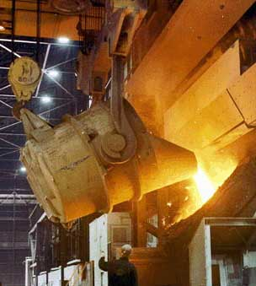
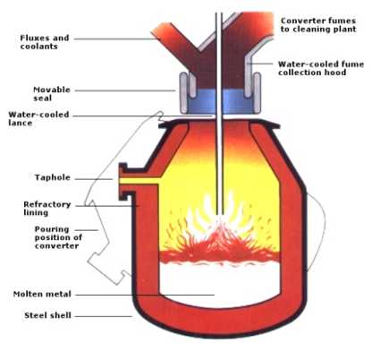
Basic Oxygen Furnace
Process Diagram
CO, CO₂
CH₄, H₂
C
and
Fe₂O₃
© ABB
June 03/2009 | Slide <number>

Slide 33


Basic Oxygen Furnace
Process Flow Diagram
1
2
3
4
Consumer
H₂O
Vapor
Heat
Exchanger
Gas
Purification
E-Filter
© ABB
June 03/2009 | Slide <number>

Slide 34
Basic Oxygen Furnace
Measuring Points
Summary
Measuring Point | Measuring Task | Measuring Components | Analyzers
1 | Process Control & Safety Monitoring | CO, CO₂, H_{2,} O₂ | Uras26 Caldos27 Magnos206
2 | Process Control & Safety Monitoring >T90, lower temperature | CO, CO₂, H_{2,} O₂ | Uras26 Caldos27 Magnos206
3 | ESP¹, Flare or Consumer - Safety Monitoring | CO, O₂ | Uras26
4 | Safety Monitoring | O₂ | LS25
Back to
Steelmaking
¹ Electrostatic Precipitator
© ABB
June 03/2009 | Slide <number>

Slide 35
Basic Oxygen Furnace
Measuring Tasks
1
-
2
Measuring task:
  Process Control & Safety Monitoring
  Components:
    CO (0...80 Vol%), CO₂ (0...40 Vol%)
    H₂ (0...10 Vol%), O₂ (0...1 Vol%)
  By analyzing the components CO and CO₂ in the process gas the refining stage may be determined and the blowing process may be timed.
  The safety during the blowing period is monitored by measuring the O₂ and often the H₂ contents for monitoring an eventual inrush of cooling water.
Back to
Steelmaking
© ABB
June 03/2009 | Slide <number>

Slide 36
Basic Oxygen Furnace
Measuring Tasks
3
Measuring task:
  Safety Monitoring (ESP, Flare or Consumer)
  Components: CO, O₂
Measuring task:
  Safety Monitoring
  Components: O₂
  Gas composition :
    O₂ : 0.1 to 0.5 vol%, typically 0.2 vol%
    CO (50 to 80 vol%) CO₂ (10 to 15 vol%) rest H₂O and N₂
    Temperature is 40 to 65°C under atmospheric pressure.
  The oxygen measurement is performed for a safe recovery of the gas with a high CO concentration into a consumer tank.
4
Back to
Steelmaking
© ABB
June 03/2009 | Slide <number>

Slide 37
Electric Arc Furnace
Process Description
An Electric Arc Furnace (EAF) is used to produce carbon and alloy steels.
Melting ferrous materials which have low or zero iron oxide content, i.e. steel scrap, is usually performed in EAFs and plays an important role in recycling.
Graphite electrodes enter the furnace and form an electric arc between the charged material and the electrode. The charge is heated both by current passing through the charge and by the radiant energy evolved by the arc.
Cycles (or “heats”) range from 1.5 to 5 hours to produce carbon steel and from 5 to 10 hours or more to produce alloy steel.
Oxygen is injected through a lance for decarburization of the melt and removal of other unwanted elements such as Phosphorous, Silicon and Sulphur and to achieve “post combustion” of Carbon Monoxide.
Flue gases comprise CO and CO₂, extremely fine iron oxide particulate and other oxidation products.
Back to
Steelmaking
© ABB
June 03/2009 | Slide <number>

Slide 38
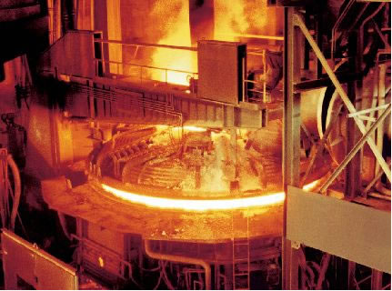
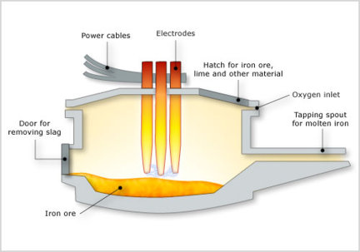
Electric Arc Furnace
Process Diagram
CO, CO₂
CH₄, H₂
C
and
Fe₂O₃
© ABB
June 03/2009 | Slide <number>

Slide 39
Electric Arc Furnace
Process Flow Diagram
1
2
Flue gas
cleaning
Off-Gas
Scrap
Lime
Coal
Molten Steel
© ABB
June 03/2009 | Slide <number>

Slide 40
Electric Arc Furnace
Measuring Points
Summary
Measuring Point | Measuring Task | Measuring Components | Analyzers
1 | EAF Offgas Monitoring Process & Safety Monitoring | CO, CO₂, O₂ | Uras26 Magnos206
2 | Emission Monitoring | CO, NO_{x}, SO₂, O₂ | Uras26 Magnos206
Back to
Steelmaking
© ABB
June 03/2009 | Slide <number>

Slide 41
Steel Refining
Process Description
After heating to the rolling temperature in a reheating furnace, the castings are hot-worked to the required products:
  Steel shapes, bars, and wire rods are worked on section and bar mills and wire-rod mills equipped with caliber rolls
  Plates are worked on reversing mills
  Hot-rolled steel sheets are worked on hot strip mills
    After pickling to remove scale from the surface, hot-rolled steel sheets are worked to cold-rolled steel sheets on reversing mills or tandem rolling mills
  Cold-rolled steel sheets are tinned or galvanized as required to produce various surface-treated steel sheet products
  Steel pipe is produced by forming and welding steel sheets or plates, or by piercing a billet and rolling to the final dimensions without a seam.
Applications for gas analyzers are found in a few of these processes.
Back to
Steel Refining
© ABB
June 03/2009 | Slide <number>

Slide 42
Heat Treatment
Process Description
Heat treatment is a method used to alter the physical, and sometimes chemical, properties of a material. There are many types of heat treating processes available to steel.
The most common are annealing, quenching and tempering:
  Annealing is a heat treatment wherein a material is altered, causing changes in its properties such as strength and hardness. It is a process that produces conditions by heating to above the re-crystallization temperature, maintaining a suitable temperature, and then cooling.
  Quench hardening (or quenching) is a mechanical process in which steel and cast iron alloys are strengthened and hardened. This is done by heating the material to a certain temperature, differing upon material, and then rapidly cooling the material.
  Tempering is a heat treatment technique for metals, alloys and glass. In steels, tempering is done to "toughen" the metal. The steel is tempered by heating between the ranges of 150°C-260°C (300°F-500°F) and 370°C-650°C (700°F-1200°F).
Back to
Steel Refining
© ABB
June 03/2009 | Slide <number>

Slide 43
Annealing Furnace
Process Description
The purpose of annealing may involve one or more of following aims:
  To soften steel and to improve machinability.
  To relieve internal stresses induced by some previous treatment (rolling, forging, uneven cooling).
  To remove coarseness of grain.
The treatment is applied to forgings, cold-worked sheets and wire, and castings. The operation consists of:
  heating the steel to a certain temperature,
  "soaking" at this temperature for a time sufficient to allow the necessary changes to occur,
  cooling at a predetermined rate.
The modern tendency is to use batch or continuous annealing furnaces with an inert purging gas (namely Hydrogen or Argon).
The low temperature of annealing may result in oxidation of the metal’s surface, resulting in scale. If scale is to be avoided, annealing is carried out in an oxygen-, carbon-, and nitrogen-free atmosphere (to avoid oxidation, carburization, and nitriding respectively).
Back to
Steel Refining
© ABB
June 03/2009 | Slide <number>

Slide 44
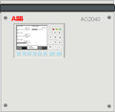
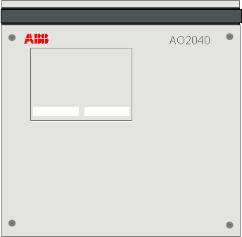
Annealing Furnace
Process Flow Diagram (Example)
Oven has a N₂ atmosphere: purged @ 60m³ per hour
ZO23 trace
<30 ppm O₂
Magnos206
<25 Vol% O₂
Uras26
<100 ppm CO₂
Zone 1
Zone 2
Zone 3
Zone 4
Zone 5
∆T₁
∆T₂
∆T₃
∆T₄
∆T₅
ca. 25 minutes
Air lock
Air lock
ca. 60 m
© ABB
June 03/2009 | Slide <number>

Slide 45
Annealing Furnace
Measuring Task (Example)
Production of various grades of steel coils:
  Steel coils are “finished” in an inert atmosphere in a continuous rolling furnace
  The furnace is approx. 60m long
  High temperatures used to imbue steel with various properties
  5 active zones (plus 2 reserve); each has different temp.
  Important that O₂ kept to min. to ensure product remains clean
Measuring Components:
  Uras26: CO₂ 0…100 ppm
  Magnos206: O₂ 0.1…25 Vol%
  ZO23: O₂ trace 0…1000 ppm
Critical points:
  Sampling at top of furnace
  Dust
  Sample flow through ZO23
Back to
Steel Refining
© ABB
June 03/2009 | Slide <number>

Slide 46


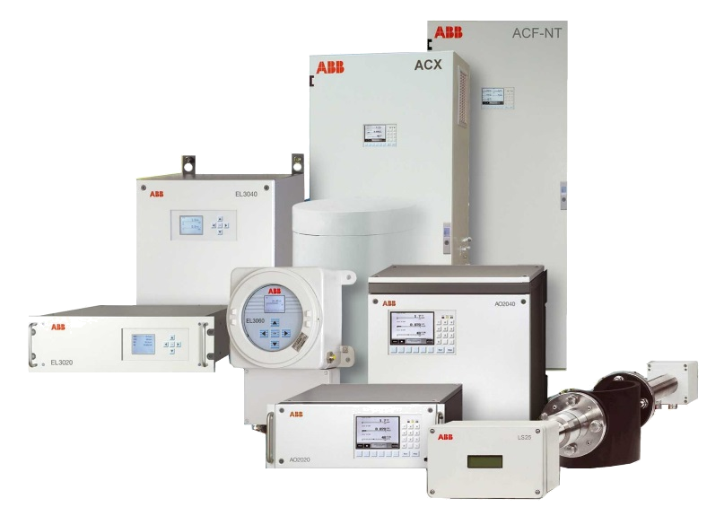
The Added Value
What you can expect from a market leader
Best choice of analyzers tailored to your needs
Certified support
wherever you are
Long-term security in your investment
Unrivalled
options for
connectivity
Most powerful software solutions
Unique time
and cost saving
calibration concepts
Assured quality through independent certification
© ABB
June 03/2009 | Slide <number>

Slide 47
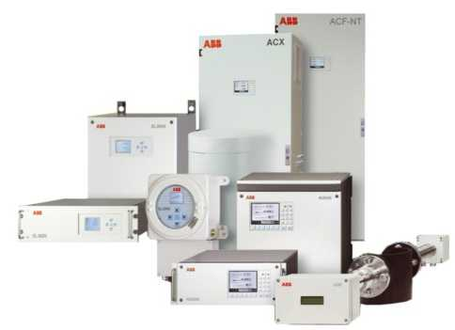
Best choice of analyzers tailored to your needs
What does it mean?
  Modular and extendable, tailored to your needs
  Lots of measuring principles under one roof
  Common, simple Human Machine Interface
  Reduced sets of spare parts
  Reduced need for training
  Multiple protection and installation methods
© ABB
June 03/2009 | Slide <number>

Slide 48
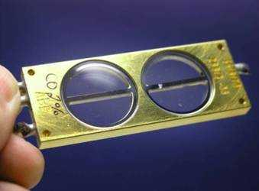
Unique time and cost saving calibration concepts
What does it mean?
  Calibration cells for true test gas without bottles
  Single point calibration with simple reference gas
  High intrinsic stability
© ABB
June 03/2009 | Slide <number>

Slide 49




Unrivalled options for connectivity
What does it mean?
  Access to the Ethernet world
  Industry standards Modbus and Profibus
  Integrated Web server
  Automation standard interface OPC
  Integration of process data
Ethernet
© ABB
June 03/2009 | Slide <number>

Slide 50
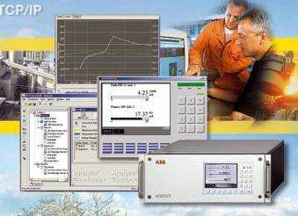
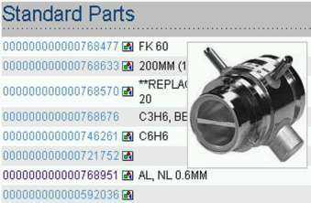
Most powerful software solutions
What does it mean?
  Integrated PLC
  Full remote operation
  Advanced service and configuration tools
  Visual spare parts catalog
  Built-in web server for quality control
  Explore your analyzers plant-wide
© ABB
June 03/2009 | Slide <number>

Slide 51
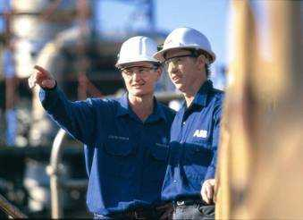
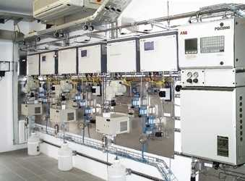
Certified support wherever you are
What does it mean?
  Manufacturer certified service engineers
  In-depth local competence
  Application competence
  Web based analyzer data for Service
  Latest product information online
  Knowledge-based analyzer configuration
© ABB
June 03/2009 | Slide <number>

Slide 52
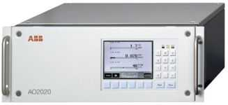
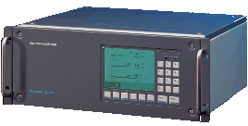
Long-term security in your investment
What does it mean?
  Comprehensive Life Cycle Policy
  Long-term availability of spares
  Long-term extendability
  Outstanding upgradeability
2009
1997
© ABB
June 03/2009 | Slide <number>

Slide 53






Assured quality through independent certification
What does it mean?
  CEMS certificates
  Hazardous area certificates
  Metrological approvals certificates
  Electrical safety certificates
  Quality management certificates
  Factory audits
© ABB
June 03/2009 | Slide <number>

Slide 54
The Added Values
Iron & Steel Production
Fastest T⁹⁰ response time of analyzers
  Critical for process control of BOF where response time is crucial
    Uras26 2 seconds
    Caldos27 2 seconds
    Magnos206 3 seconds
Lowest drift rate of analyzers
  Highest stability and reliability of measurement, reduced maintenance
    Uras26 (with cal cell) ≤ 0.3% per year
    Caldos27 ≤ 2% of smallest possible range per week
    Magnos206 ≤ 0.25% per year
Internal cross sensitivity correction using Function Blocks
  Improved performance and reliability of system
    Using raw values for authentic and fast response
    External converters not required
© ABB
June 03/2009 | Slide <number>

Slide 55


